Slide 1
Chapter Two HTML Tags

Slide 2
1.Basic HTML Tags
1.1 HTML: Hypertext Markup Language
HTML stands for Hypertext Markup Language.
It is the markup language used for creating web pages.
A markup language is a set of markup tags, and HTML uses markup tags to describe web pages.
HTML is written in the form of HTML elements consisting of HTML tags surrounded by angle brackets (e.g. <html>).
HTML tags normally come in pairs like <b> and </b>.
The first tag in a pair is the start tag, the second tag is the end tag
You can also refer to them as opening tags and closing tags.

Slide 3
1.Basic HTML Tags…
HTML elements form the building blocks of all websites.
HTML allows images and objects to be embedded and can be used to create interactive forms.
It provides a means to create structured documents by denoting structural semantics for text such as headings, paragraphs, lists, links, quotes and other items.
It can embed scripts in languages such as JavaScript which affect the behavior of HTML webpage.
HTML can also be used to include Cascading Style Sheets (CSS) to define the appearance and layout of text.

Slide 4
1.Basic HTML Tags…
Software is required to interpret HTML tags and display the information.
The software is web browser.
The purpose of a web browser is to read HTML documents and display them as web pages.
The browser does not display the HTML tags, but uses the tags to interpret the content of the page
World Wide Web Consortium (W3C) is the organization that develops guidelines and specifications for many web technologies including HTML.
The W3C website is found at www.w3.org.

Slide 5
1.Basic HTML Tags…
1.2 HTML, HEAD, TITILE and BODY Tags
The entire web page document is contained within an <html> tag.
The <html> tag is called the root element because it contains all the elements in the document, and it cannot not be contained within any other element.
Every web page starts with <html> tag and ends with </html>

Slide 6
1.Basic HTML Tags…
Let us first see how a plain html code looks like.
<html> <head> <title>Page title here </title> </head> <body> Our body content here </body> </html>

Slide 7
1.Basic HTML Tags…
The total code is divided into two parts and both the parts are kept inside <html> tag.
Our page should start with <html> and end with </html>.
The first part inside this html tags is the head and it starts with <head> and ends with </head>.
The second part starts with <body> and ends with </body> tag.
Inside the <body> tag we keep all our content which we want to display to our web page users.
Whatever we place in <body> will be displayed by the browser to the web users.

Slide 8
1.Basic HTML Tags…

Slide 9
1.Basic HTML Tags…
<HEAD> </HEAD>
The web page should have only one head tag.
The head tag starts with <head> and ends with </head>.
The text or tags that are inside the head tag will not be displayed in the browser window.
One of the important tags which is put inside <head> is <title> </title> tag.
Title tags are used to give title to the browser window.
Title tags are also important for our search engine point of view.
We should keep most important keywords inside the title tag.

Slide 10
1.Basic HTML Tags…
Example:
<html>
<head>
<title> Nuclear Energy </title>
</head>
<body>
Nuclear energy is one of the clean environment friendly energy source.
</body>
</html>

Slide 11
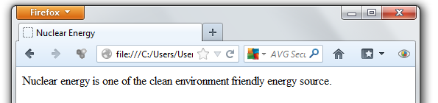
1.Basic HTML Tags…
It is also possible to put JavaScript code and Cascading Style Sheets in head section.
If we are adding any JavaScript code here then that will be loaded when the browser opens the page.

Slide 12
1.Basic HTML Tags…
<BODY> </BODY>
This is where we place our content for our visitors.
What we place here will be displayed to our visitors.
The style and other formatting of the text and what you could do to fill the content of the web page will discuss in different sections.
A <body> element may contain anything from a couple of paragraphs under a heading to more complicated layouts containing forms and tables.

Slide 13
1.Basic HTML Tags…
The <title> Element
You should specify a title for every page that you write inside the <title> element.
This element is a child of the <head> element.
It is used in several ways:
It displays at the very top of a browser window.
It is used as the default name for a bookmark in browsers.
Its is used by search engines that use its content to help index pages.
Example: Here is the example of using title tag.
<head>
<title>HTML Basic tags</title>
</head>

Slide 14
1.Basic HTML Tags…
HTML Tag Attributes
HTML tags can have attributes
Attributes provide additional information about a tag
Attributes are always specified in the start tag
Attributes come in name/value pairs like: name="value"
The syntax for attributes is as follows:
<element attribute-name="value"> Content </element>
or for empty elements:
<element attribute-name="value" />
Example: the background color of HTML document can be changed using “bgcolor” attribute of the <body> tag.
<body bgcolor=”green”>

Slide 15
1.Basic HTML Tags…
<html> attribute
Setting HTML Language
The HTML lang attribute can be used to declare the language of a Web page or a portion of a Web page.
This is meant to assist search engines and browsers.
According to the W3C recommendation you should declare the primary language for each Web page with the lang attribute inside the <html> tag, like this:
<html lang="en">
…
</html>

Slide 16
1.Basic HTML Tags…
ISO 639-1 defines abbreviations for languages.
In HTML, they can be used in the lang attributes.
Language | ISO Code
Chinese | zh
English | en
French | fr
German | de
Russian | ru
Local language
Afar | aa
Amharic | am
Afan Oromo | om
Somali | so
Tigrinya | ti

Slide 17
1.Basic HTML Tags…
<html lang=“ru">
<head>
<title>Setting Language</title>
</head>
<body>
This web page in Russian
</body>
</html>

Slide 18
1.Basic HTML Tags…
<body> Attributes
a. Background Color
You can change background color of your web page by using <BODY> tag attribute bgcolor
<body bgcolor=”green”>
Color can be specified using color name or RGB value.
The following also sets background color to green:
<body bgcolor=”#00FF00”>

Slide 19
1.Basic HTML Tags…
b. Background Image
We can use a background picture for web page instead of background color.
You must have an image to do this.
Then you can use background attribute of <BODY> tag as follows:
<body background="image1.gif">
c. Text Color
We can also set the text color of the web page just like background color.
We use text attribute of <BODY> to do this.
<body bgcolor=”yellow” text="red">

Slide 20
1.Basic HTML Tags…
Example:
<HTML>
<HEAD>
<TITLE>Page with Back Color</TITLE>
</HEAD>
<BODY bgcolor="yellow" text="#FF0000">
Page with yellow back color and red text color
</BODY>
</HTML>

Slide 21
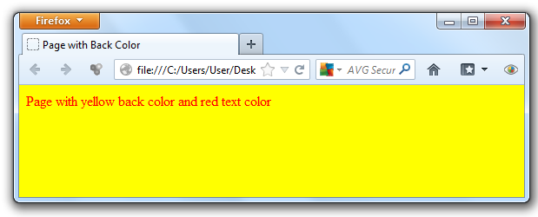
1.Basic HTML Tags…
Fig Back and text colors of body

Slide 22
1.Basic HTML Tags…
Other <body> attributes
alink: sets the color for active links or selected links.
link: sets a color for link text.
vlink: sets a color for visited links - that is, for linked text that you have already clicked on.
<html>
<head>
<title> Link Colors </title>
</head>
<body alink="#00A000“ link="#00FF00" vlink="#0000FF">
<a href="first.html">first page</a><br>
<a href="first1.html"> second page</a><br>
</body>
</html>

Slide 23
1.Basic HTML Tags…
Meta Tag
The <meta> tag provides metadata about the HTML document.
Metadata is data (information) about data.
Metadata will not be displayed on the page, but will be machine parseable.
Meta elements are used to specify page description, keywords, author of the document, last modified, and other metadata.
The metadata can be used by browsers (how to display content or reload page), search engines (keywords), or other web services.
<meta> tags always goes inside the <head> element.
Metadata is always passed as name/value pairs.
The content attribute must be defined if the name or the http-equiv attribute is defined.
if none of these are defined, the content attribute cannot be defined.

Slide 24
1.Basic HTML Tags…
Attribute | Value | Description
http-equiv | content-type | Provides an HTTP header for the information/value of the content attribute
 | default-style
 | refresh
name | application-name | Specifies a name for the metadata
 | author
 | description
 | generator
 | keywords
content | text | Gives the value associated with the http-equiv or name attribute

Slide 25
1.Basic HTML Tags…
The keywords attribute
Keywords meta tag defines keywords for search engines.
It was a critical element for early search engines to index the page.
Today, search engines no longer depend on keywords meta tag to index the page.
The structure is as follows:
<meta name="keywords" content="HTML, CSS, XML, XHTML, JavaScript">

Slide 26
1.Basic HTML Tags…
The description attribute
The description attribute provides a concise explanation of a Web page's content.
The description attribute is supported by most major search engines, like Yahoo! and Bing, while Google will fall back on this tag when information about the page itself is requested.
The structure is as follows:
<meta name="description" content="Free Web tutorials on HTML, CSS, XML and JavaScript">

Slide 27
1.Basic HTML Tags…
The robots attribute
The robots tag is still one of the most important tags.
The robots meta tag lets you specify that a particular page should not be indexed by a search engine or if you do or do not want links on the page to be followed.
<meta name="robots" content="noindex, nofollow">
This means “Do not Index this page, do not follow the links on the page.”
Your page will drop out of the search index and your links to other pages will not be followed.
This tag is most often used when a site is in development.

Slide 28
1.Basic HTML Tags…
Other values are:
<meta name="robots" content="index, nofollow">
<meta name="robots" content="noindex, follow">
<meta name="robots" content="index, follow">
The refresh attribute
We can tell the web page to refresh itself every given seconds.
<meta http-equiv="refresh" content="30">
We can tell the page to redirect/refresh within the given seconds.
<meta http-equiv="refresh" content="x_seconds; url=http://www.yourhost.com/pagetosendto.html">

Slide 29
1.Basic HTML Tags…
The content-type attribute
The content-type attribute specifies the default charset for plain text using meta:
<meta http-equiv="Content-Type" content="text/html; charset=UTF-8" >
The expires attribute
The expires attribute specifies when the content should be refreshed from the webserver:
<meta http-equiv="Expires" content="Tue, 20 Aug 1996 14:25:27 GMT “>
This will result in the HTTP header:
Expires: Tue, 20 Aug 1996 14:25:27 GMT
This can be used by caches to determine when to fetch a fresh copy of the associated document.

Slide 30
1.Basic HTML Tags…
The author attribute
The author attribute defines the author of the page. The structure is:
<meta name="author" content="John Li">

Slide 31
1.Basic HTML Tags…
Creating Links
A hyperlink (or link) is a word, group of words, or image that you can click on to jump to a new document or a new section within the current document.
Web pages can contain links that take you directly to other pages or specific parts of the given page.
These links are known as hyperlinks.
Hyperlinks allow visitors to navigate between Web sites by clicking on words, phrases, and images.
Thus you can create hyperlinks using text or images available on your web page.

Slide 32
1.Basic HTML Tags…
Links are specified in HTML using the <a> tag.
This element is called anchor tag as well.
Anything between the opening <a> tag and the closing </a> tag becomes part of the link.
The <a> tag can be used in two ways:
To create a link to another document, by using the href attribute
To create a bookmark inside a document, by using the name attribute

Slide 33
1.Basic HTML Tags…
The href Attribute:
A link in HTML is always composed of two parts, the clickable part (the link text) and the URL (the destination site, page or resource).
The URL is specified using href attribute.
Here is an example:
<a href=” http://mail.yahoo.com”> Yahoo mail</a>
The target attribute
It is used to specify where to display the contents of a selected hyperlink.
If set to:
_blank then a new window will be opened to display the loaded page
_top or _parent then same window will be used to display the loaded document.
_self then loads the new page in current window. By default its _self.

Slide 34
1.Basic HTML Tags…
Example: a link that opens on a new window
<a href="first.html" target="_blank"> First Page</a><br>
The name Attribute
The name attribute specifies the name of the anchor.
The name attribute is used to create a bookmark inside an HTML document.
Bookmarks are invisible to the reader.
Example: A named anchor inside an HTML document:
<a name="example">Sample Examples</a>
Then create a link to the "Sample Examples" inside the same document:
<a href="#example">Go to Sample Example</a>

Slide 35
1.Basic HTML Tags…
The title attribute
The title attribute is used to type a short description of the link.
If you place the cursor over the link, you will see the text in the title attribute.
Example:
<a href="http://www.html.net/" title="Visit html.net and learn HTML">Learn HTML </a>
The accesskey attribute:
The accesskey attribute provides a keyboard shortcut to activate the link.
For example, you could make the T key an access key so that when the user presses either the Alt or Ctrl key on his keyboard along with the T key, the link gets activated.
Example:
<a href="first.html" target="_blank" accesskey="m">First page</a>

Slide 36
1.Basic HTML Tags…
Linking to email
It is also possible to make a link to an e-mail address.
It is done in almost the same way as when you link to a document.
To link to an email, you type mailto: followed by an e-mail address.
Example:
<a href="mailto:home@gmail.com">Send an e-mail to us </a>
When the link is clicked, the default e-mail program opens with a new blank message addressed to the specified e-mail address.
This function will only work if there is an e-mail program installed on your computer.

Slide 37
2. HTML Text Formatting Tags
There are options if one wants to create a text in HTML.
Let’s see some of the tags than can be used to create text information.
HTML Headings
In HTML, you can create different heading levels in your document to help you organize the document into sections, just as you might do when writing a book.
A heading element briefly describes the topic of the section it introduces.
Headings are defined with the <h1> to <h6> tags.
<h1> defines the largest heading and <h6> the smallest heading.

Slide 38
2. HTML Text Formatting Tags…
Heading tags are block tags, and you must specify opening and closing tags.
Example:
<body>
<h1>this is heading level 1.</h1>
<h2>this is heading level 2.</h2>
<h3>this is heading level 3.</h3>
<h4>this is heading level 4.</h4>
<h5>this is heading level 5.</h5>
<h6>this is heading level 6.</h6>
</body>

Slide 39
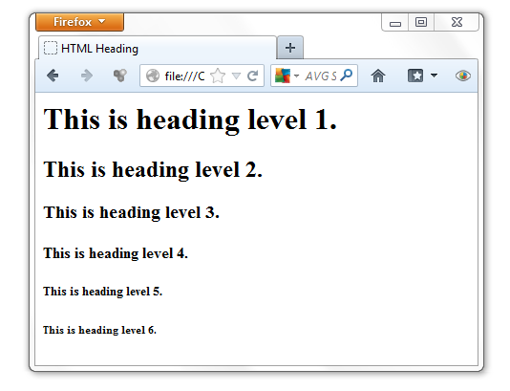
2. HTML Text Formatting Tags…

Slide 40
2.HTML Text Formatting Tags…
HTML Paragraphs
Authors traditionally divide their thoughts and arguments into sequences of paragraphs.
Along with using headings to structure your Web page, you can add structure by grouping common text into paragraphs.
Paragraphs are defined with the <p> tag.
Example:
<p>This is a paragraph</p>
<p>This is another paragraph</p>
Both of the above tags will enforce a new line whenever you write the tag.

Slide 41
2.HTML Text Formatting Tags…
The <p> element is a block element.
It cannot contain block-level elements including <p> itself.
The align attribute
You can use align attribute to align your paragraphs.
Paragraphs can be aligned left, center, right or justified.
You can do this by using align attribute.
Align attribute can be used also with other tags like headers, etc.
Example:
<p align="center">This is center aligned.</p>
<p align="justify">This is jutified. This works when you have multiple lines in your paragraph and you want to justify all the lines so that they can look more nice.</p>

Slide 42
2.HTML Text Formatting Tags…
HTML Fonts
The <font> tag is used to add font type, size, and color to the text on your site.
The font tag is has three attributes
size,
color, and
face
They are used to customize your fonts.
To change any of the font attributes at any time within your page, simply use the <font> tag.
The text that follows will remain changed until you close with the </font> tag.
You can change any or all of the font attributes at the one time.

Slide 43
2.HTML Text Formatting Tags…
Font Size:
You can set the size of your font with size attribute.
The range of accepted values is from 1(smallest) to 7(largest).
The default size of a font is 3.
Example:
<font size="1">Font size=1</font>
<font size="2">Font size=2</font>
<font size="3">Font size=3</font>
<font size="4">Font size=4</font>
<font size="5">Font size=5</font>
<font size="6">Font size=6</font>
<font size="7">Font size=7</font>

Slide 44
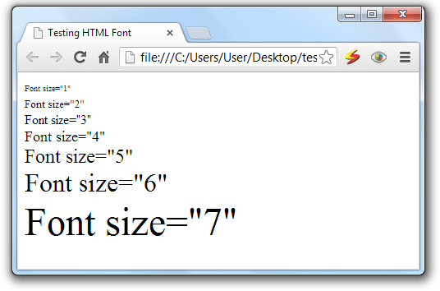
2.HTML Text Formatting Tags…

Slide 45
2.HTML Text Formatting Tags…
Specify Relative Font Size
You can also specify relative font sizes instead of exact font size.
This can be done like:
<font size="+n">
<font size="-n">
This specifies how many sizes larger or how many sizes smaller than the preset font size should be.
Example:
<font size="-1">Font size="-1"</font>
<font size="+1">Font size="+1"</font>
<font size="+2">Font size="+2"</font>
<font size="+3">Font size="+3"</font>
<font size="+4">Font size="+4"</font>

Slide 46
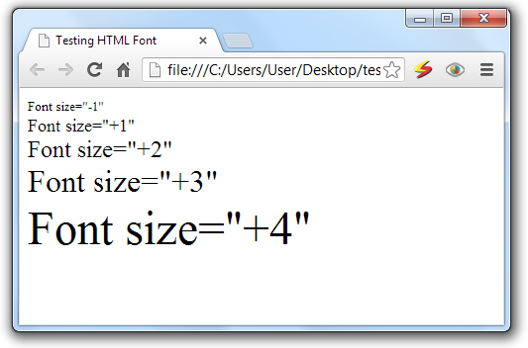
2.HTML Text Formatting Tags…

Slide 47
2.HTML Text Formatting Tags…
Font Face:
You can set any font you like using face attribute
But be aware that if the user viewing the page doesn't have the font installed, they will not be able to see it.
Instead they will default to Times New Roman of your font with size attribute.
Example:
<font face="Times New Roman" size="5"> Times New Roman </font>
<font face="Verdana" size="5"> Verdana </font>
<font face="Comic sans MS" size="5"> Comic Sans MS </font>
<font face="WildWest" size="5"> WildWest </font>

Slide 48
2.HTML Text Formatting Tags…
A visitor will only be able to see your font if they have that font installed on their computer.
So, it is possible to specify two or more font face alternatives by listing the font face names, separated by a comma.
Example:
<font face="arial, helvetica">
<font face="Lucida Calligraphy, Comic Sans MS, Lucida Console>

Slide 49
2.HTML Text Formatting Tags…
Font Color:
You can set any font color you like using color attribute.
You can specify the color that you want by either the color name or hexadecimal code for that color.
Check a complete list of HTML Color Name with Codes.
Example:
<font color="#0000FF">This text blue color</font>
<font color="red">This text is red</font>

Slide 50
2.HTML Text Formatting Tags…
The <basefont> Element:
The <basefont> element is used to set a default font size, color, and typeface for any parts of the document that are not otherwise contained within a <font> element.
You can then use the <font> elements to override the <basefont> settings.
The attributes that the <basefont> element takes are exactly the same as for the <font> element.
You can also set the size of fonts relative to the size of the <basefont> by giving them a value of +1 for a size larger or -1 for two sizes smaller.

Slide 51
2.HTML Text Formatting Tags…
Example:
<basefont face="arial, verdana, sans-serif" size="2" color="#ff0000">
<p>This is the page's default font.</p>
<h2>Example of the &lt;basefont&gt; Element</h2>
<p><font size="+2" color="darkgray">Here is some darkgray text two sizes larger</font></p>
<p><font face="courier" size="-1" color="#000000">Here is a courier font, a size smaller, in black</font></p>

Slide 52
2.HTML Text Formatting Tags…
Formatting Tags
In HTML, there are many tags that you can use to enhance and change the look of the text.
You can make text bold, italicized, or underlined; these are just some of the presentational options available to indicate how text can appear in HTML.
Bold Text - The <b> Element:
Anything that appears in a <b>...</b> element is displayed in bold.
The <b> tag makes text to be displayed in bold face.

Slide 53
2.HTML Text Formatting Tags…
Example:
<p>The use of nuclear energy needs <b> safety caution </b> because of the associated danger.</p>
This will produce following result:
The use of nuclear energy needs safety caution because of the associated danger.
Italic Text - The <i> Element:
Anything that appears in a <i>...</i> element is displayed in italicized face.
Example:
<p>The following word uses an <i>italicized</i> typeface.</p>
This will produce following result:
The following word uses an italicized typeface.

Slide 54
2.HTML Text Formatting Tags…
Underlined Text - the <u> Element:
Anything that appears in a <u>...</u> element is displayed with underline.
Example:
<p>The following word uses a <u>underlined</u> typeface.</p>
This will produce following result:
The following word uses a underlined typeface.

Slide 55
2.HTML Text Formatting Tags…
Centering Content - the <center> Element:
You can use <center> tag to put any content in the center of the page or any table cell.
Example:
<p>This is not in the center.</p>
<center> <p>This is in the center.</p> </center>

Slide 56
2.HTML Text Formatting Tags…
Strike Text - the <strike> Element:
Anything that appears in a <strike>...</strike> element is displayed with strikethrough, which is a thin line through the text.
Example
<p>The following word uses a <strike>strikethrough</strike> typeface.</p>
This will produce following result:
The following word uses a strikethrough typeface.

Slide 57
2.HTML Text Formatting Tags…
Create Line Breaks - The <br> Element:
The <br> tag inserts a single line break.
You can also use <br /> which does the same.
Whenever you use the <br> element, anything following it starts on a new line.
This tag is an example of an empty element, where you do not need opening and closing tags, as there is nothing to go in between them.
The <br /> element has a space between the characters br and the forward slash.
If you omit this space, older browsers will have trouble rendering the line break, while if you miss the forward slash character and just use <br> it is not valid XHTML.

Slide 58
2.HTML Text Formatting Tags…
Example
Hello<br>
You come most carefully upon your hour.<br />
Thanks<br>
Mahnaz
This will produce following result:
Hello
You come most carefully upon your hour.
Thanks
Mahnaz

Slide 59
2.HTML Text Formatting Tags…
Preserve Formatting - The <pre> Element:
Sometimes you want your text to follow the exact format of how it is written in the HTML document.
In those cases, you can use the preformatted tag (<pre>).
The <pre> tag defines preformatted text.
Text in a pre element is displayed in a fixed-width font (usually Courier),
It preserves both spaces and line breaks.
Example:
<pre>
function testFunction( int a, int b ){
int sum = a + b;
alert (sum);
return;
}
</pre>

Slide 60
2.HTML Text Formatting Tags…
This produces the following output:
function testFunction( int a, int b ){
var sum = a + b;
alert (sum);
return;
}

Slide 61
2. HTML Text Formatting Tags…
Horizontal Rules - The <hr> Element
<hr> stands horizontal rules are used to visually break up sections of a document.
The <hr> tag creates a horizontal line in an HTML page.
The hr element can be used to separate content in an HTML page.
For example you may want to give a line between two paragraphs as follows:
<p>This is paragraph one and should be on top</p>
<hr>
<p>This is paragraph two and should be at bottom</p>
This produces the following output:
This is paragraph one and should be on top
____________________________________________________________
This is paragraph two and should be at bottom

Slide 62
2. HTML Text Formatting Tags…
Example:
<p>This is paragraph one and should be on top</p>
<hr size=”5” width=”50” align=”center”>
Attribute | Value | Description
align | Left Center right | Deprecated. Use styles instead. Specifies the alignment of a hr element
noshade | noshade | Deprecated. Use styles instead. Specifies that a hr element should render in one solid color (noshaded), instead of a shaded color
size | pixels | Deprecated. Use styles instead. Specifies the height of the hr element
width | Pixels % | Deprecated. Use styles instead. Specifies the width of the hr element

Slide 63
2. HTML Text Formatting Tags…
Subscript and Superscript Text:
The <sub> tag defines subscript text.
Subscript text appears half a character below the baseline.
Used for chemical formulas, like H₂O.
The <sup> tag defines superscript text.
Superscript text appears half a character above the baseline.
Used for mathematical expressions like x²+y or footnotes, like HTTP^{[1]}.
Example:
<p> The chemical formula for water is H<sub>2</sub>O </p>
<p> Solve 5X<sup>2</sup>+6X+10 </p>

Slide 64
2. HTML Text Formatting Tags…
Big and small Text:
The <big> tag displays texts in big.
The content of the <big> element is displayed one font size larger than the rest of the text surrounding it.
The <small> tag renders a smaller text.
The content of the <small> element is displayed one font size smaller than the rest of the text surrounding it.

Slide 65
2. HTML Text Formatting Tags…
Example:
<html>
<head>
<title>Formatting Tags</title>
</head>
<body>
<font size="5">
<p> The chemical formula for water is H<sub>2</sub>O </p>
<p> Solve 5X<sup>2</sup>+6X+10 </p>
<p>The following word uses a <small>small</small> typeface.</p>
<p>The following word uses a <big>big</big> typeface.</p>
</font>
</body>
</html>

Slide 66
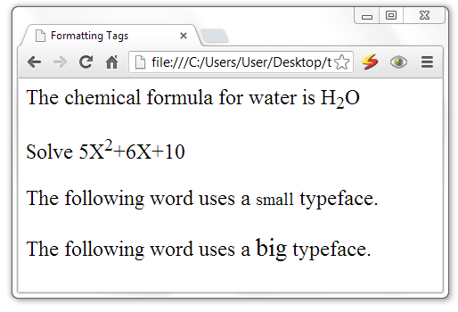
2. HTML Text Formatting Tags…

Slide 67
2. HTML Text Formatting Tags…
Bidirectional Text - <bdo> Tag
bdo stands for bidirectional override.
The <bdo> tag allows you to specify the text direction and override the bidirectional algorithm.
This is especially useful for languages like Hebrew and Arabic where text is written from right to left.
Example:
<bdo dir="rtl">Here is some Hebrew text!</bdo>
This produces the following output:

Slide 68
2. HTML Text Formatting Tags…
Tag | Description
<em> | Renders as emphasized text
<strong> | Renders as strong (highlighted) text
<dfn> | Defines a definition term
<code> | Defines computer code text
<samp> | Defines sample output from computer code
<kbd> | Defines keyboard text
<var> | Defines a variable part of a text
<cite> | Defines a citation
<abbr> | Defines an abbreviation
<acronym> | Defines an acronym
<q> | Defines a short quotation.
<blockquote> | To quote a passage from another source

Slide 69
2. HTML Text Formatting Tags…
<html>
<head> <title>HTML Tags</title>
</head>
<body>
<abbr title="World Health Organization">WHO</abbr> reports that malaria epidemic is increasing. <br>
Two <acronym title="North Atlantic Treaty Organization">NATO</acronym> troops are killed in Afghanistan. <br>
<em>Emphasized text</em> <br>
<strong>Strong text</strong> <br>
<dfn>Definition term</dfn> <br>
<code>Computer code text</code> <br>
<samp>Sample computer code text</samp> <br>
<kbd>Keyboard text</kbd> <br>
<var>Variable</var> <br>
<cite>Citation</cite> <br>
</body>
</html>

Slide 70
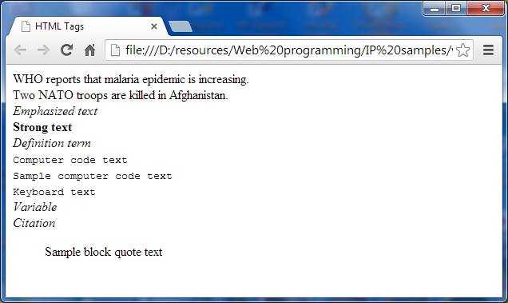
2. HTML Text Formatting Tags…

Slide 71
2. HTML Text Formatting Tags…
Special Characters
Characters within HTML documents that are not part of a tag are rendered as-is by the browser.
However, some characters have special meaning and are not directly rendered, while other characters can't be typed into the source document from a conventional keyboard.
Special characters need either a special name or a numeric character encoding for inclusion in an HTML document.

Slide 72
Character | Code | Short name | Character name
" | &#34; | &quot; | quotation mark
' | &#39; | &apos; | apostrophe
& | &#38; | &amp; | ampersand
< | &#60; | &lt; | less-than
> | &#62; | &gt; | greater-than
 | &#160; | &nbsp; | non-breaking space
¡ | &#161; | &iexcl; | inverted exclamation mark
¢ | &#162; | &cent; | cent
£ | &#163; | &pound; | pound
¤ | &#164; | &curren; | currency
¥ | &#165; | &yen; | yen
¦ | &#166; | &brvbar; | broken vertical bar
§ | &#167; | &sect; | section
¨ | &#168; | &uml; | spacing diaeresis
© | &#169; | &copy; | copyright
ª | &#170; | &ordf; | feminine ordinal indicator
« | &#171; | &laquo; | angle quotation mark (left)
¼ | &#188; | &frac14; | fraction 1/4
½ | &#189; | &frac12; | fraction 1/2
¾ | &#190; | &frac34; | fraction 3/4
¿ | &#191; | &iquest; | inverted question mark
× | &#215; | &times; | multiplication
÷ | &#247; | &divide; | division

Slide 73
¬ | &#172; | &not; | negation
­­ | &#173; | &shy; | soft hyphen
® | &#174; | &reg; | registered trademark
¯ | &#175; | &macr; | spacing macron
° | &#176; | &deg; | degree
± | &#177; | &plusmn; | plus-or-minus
² | &#178; | &sup2; | superscript 2
³ | &#179; | &sup3; | superscript 3
´ | &#180; | &acute; | spacing acute
µ | &#181; | &micro; | micro
¶ | &#182; | &para; | paragraph
· | &#183; | &middot; | middle dot
¸ | &#184; | &cedil; | spacing cedilla
¹ | &#185; | &sup1; | superscript 1
º | &#186; | &ordm; | masculine ordinal indicator
» | &#187; | &raquo; | angle quotation mark (right)
¼ | &#188; | &frac14; | fraction 1/4
½ | &#189; | &frac12; | fraction 1/2
¾ | &#190; | &frac34; | fraction 3/4
¿ | &#191; | &iquest; | inverted question mark
× | &#215; | &times; | multiplication
÷ | &#247; | &divide; | division

Slide 74
2.HTML Text Formatting Tags…
Tags and Their Attributes
The <p>, <center>, <b>, <i>, <u>, <pre>, <strike>, <s> tags support the following standard attributes:
attribute | value | description
dir | ltr rtl | Specifies the text direction for the content in an element
lang | language_code | Specifies a language code for the content in an element
title | text | Specifies extra information about an element

Slide 75
HTML Comments
Comments are piece of code which is ignored by any web browser.
It is good practice to comment your code, especially in complex documents, to indicate sections of a document, and any other notes to anyone looking at the code.
Comments help you and others understand your code.
HTML comment are indicated by beginning tag <!-- and ending tag -->
You can comment multiple lines by the special beginning tag <!-- and ending tag --> placed before the first line and end of the last line to be treated as a comment.
For example: Given line is a valid comment in HTML
<!-- This is commented out -->

Slide 76
Inserting Image
Images are very important to beautify as well as to depicts many concepts on your web page.
It is often said that an single image is worth than thousands of words.
So as a Web Developer you should have clear understanding on how to use images in your web pages.
In HTML, images are defined with the <img> tag.
The <img> tag has attributes, but not closing tag.
To display an image on a page, you need to use the src attribute.
The value of the src attribute is the URL of the image you want to display.

Slide 77
Inserting Image…
Syntax for inserting an image:
<img src="url" alt="Alternative Text"/>
The alt attribute
The required alt attribute specifies an alternate text for an image, if the image cannot be displayed.
The alt attribute provides alternative information for an image if a user for some reason cannot view it
This could be because of slow connection, an error in the src attribute.
Example:
<img src="boat.gif" alt="Big Boat" />

Slide 78
Inserting Image…
The width and height attributes
To define the height and width of the image, rather than letting the browser compute the size, use the height and width attributes.
The attributes:
width: sets width of the image.
This can have a value like 10 or 20% etc.
height: sets height of the image.
This can have a value like 10 or 20% etc.
Example:
<img src=”sunset.jpg” height=”50” width=”100%”>

Slide 79
Inserting Image…
The border attribute
The border attribute sets a border around the image.
This will have a value like 1 or 2 etc.
The align attribute
The align attribute sets horizontal alignment of the image and takes value either left, right or center.
Example:
<img src="coffee.gif" alt="Highland coffee" width="100" height="100" border="2" align="right" title=“Coffee products" />

Slide 80
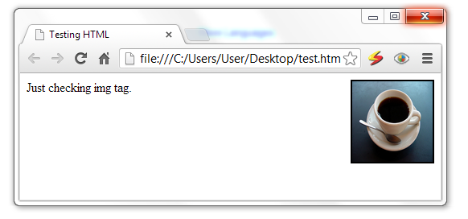
Inserting Image…

Slide 81
Inserting Image…
The valign attribute
The valign attribute sets vertical alignment of the image and takes value either top, bottom or center.
The hspace and vspace attributes
hspace: sets horizontal space around the image.
This will have a value like 10 or 20% etc.
vspace: sets vertical space around the image.
This will have a value like 10 or 20% etc.
The title attribute
The title attribute specifies a text title.
The browser displays the title when the mouse passes over the link.

Slide 82
Inserting Image…
Example:
<html>
<head>
<title>Testing HTML</title>
</head>
<body>
Just checking img tag.
<img src="coffee.png" alt="Highland coffee" align=“right" hspace="50" vspace="100">
</body>
</html>

Slide 83
Inserting Image…
Fig Image insertion

Slide 84
Image Map
Image maps enable you to define multiple links within a single image.
For example, if you have a picture of African countries, you can create links in the image that opens each country’s picture/page for detailed information.
Clickable regions within image maps can be basic shapes like rectangles and circles or complex polygonal shapes.

Slide 85
Image Map…
The following diagram is the image used in this section to show how a basic image map is created.
It contains three geometric shapes that will be turned into clickable hot-spots.

Slide 86
Image Map…
The image is added to the web page in the usual way, but with the addition of a usemap attribute, whose value must be preceded by a hash sign (#).
Example:
<img src="image-map-image.gif" alt=“image map“ width="398"
height="398" usemap="#shapes" />
The value of the usemap attribute must correlate with the id values of the associated map element.
The name attribute is required for backward compatibility, whereas the id attribute is mandatory.
<map id="shapes" name="shapes">
</map>

Slide 87
Image Map…
To create the map used by img tag, we use the following tags and attributes:
<map> tag maps information for an imagemap
name="text" - The legacy method for giving the map a name
id="text" - The current method for giving the map a name
<area> tag contains information for a clickable area in an imagemap.
The <area> element specifies the shape and the coordinates that define the boundaries of each clickable hotspot.
shape="rect|circle|poly" - shape of the linked area
coords="numbers" - pixel coordinates for the linked area
href="url" - target file for the link

Slide 88
Image Map…
The map element acts as a container for specifications regarding the map’s active areas, which are added as area elements.
<img src="image-map-image.gif" alt="Shapes" width="398" height="398" usemap="#shapes" />
<map id="shapes" name="shapes">
<area shape="rect" coords="29,27,173,171" href="square.html“ title="Access the squares page">
<area shape="circle" coords="295,175,81" href="circle.html“ title="Access the circles page">
<area shape="poly" coords="177,231,269,369,84,369" href="triangle.html" alt="A triangle“ title="Access the triangles page">
</map>

Slide 89
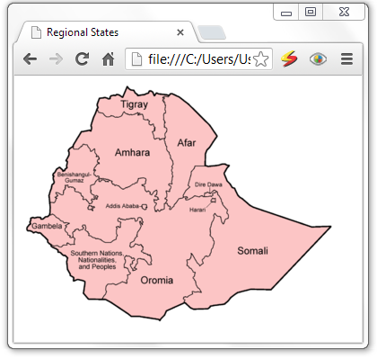
Image Map…
Suppose you want to create clickable image map of regional states like the following:

Slide 90
<html>
<head> <title>Regional States</title> </head>
<body>
<img src="Ethiopia_regions.png" width="350" height="269" usemap="#map" />
<map name="map" id=”map”>
<area shape="poly" coords="85,30,86,16,96,17,97,18, 99,17,100,14,108,13,112,16,118,4, 122,7,125,8,129,14,137,13,143,8,147,12,148,15,151,12,162,12,163,15,157,16,158,22,160,34,158,42,159,49,162,52,160,61,148,62,146,54,148,51,147,45,142,46,141,40,136,41,134,34,128,34,118,35,114,32,109,38,99,36,92,36,90,33,84,32,84,30" href="Tigray.html" />
<area shape="poly" coords="83,32,79,42,78,53,68,53,65,55,57,70,58,74,63, 74,69,68,74,69,76,76,81, 73,82,79,86,83,81,95,81,102,87,106,98,108,101, 112,108,114,113,118,129,111,131,105,139,106,135,114,139,121,144,122,150,120,150,126,153,129,148,131,151,135,149,142,156,141,160,139,160,134,162,130,162,120,167,115,168,111,168,96,168,85,165,78,159,62,149,63,146,55,148,47,143,46,141,41,136,40,133,34,123,35,117,34,115,32,110,38,104,38,96,36,85,32,84,32" href="Amhara.html" />
<area shape="poly" coords="163,14,169,11,197,34,218,59,207,77, 205,92,194,92,189,100,186,115, 187, 117,181,121,180,127,177,129,175,129,166, 141,164,137,161,136,161,134,162,121,167,115,168,99,168,87,161,71,158,62,161,52,158,45,159,36,159,27,158,16" href="Afar.html" />
<area shape="poly" coords="56,71,52,75,51,84,50,95,48,97,43,94,36,99,35,107, 36,111,32,119,31, 128, 31,133,38,133,40,125,38,121,42,123,46, 124,48,116,50,112, 53,115,59,116,60,120,65,123,69,126,75,132,78,134,79,129,86,128,81,124,77,122,77,114,83,110,87,106,81,101,81,94,86,84,83,78,81,73,77,75,74,69,69,68,63,74,59,74,56,72" href="Benishangul.html" />

Slide 91
<area shape="poly" coords="32,146,37,147, 44,153,48,155,54,155,50,158,49,166, 53,170,58,172,59, 177,58,180,52,179,51,177,50,180,46,180,43,183,39,180,35,181,30,176,27,170,20,166,13,166,5,164,6,159,9,156,10,150,21,149,23,151,32,148,32,146" href="Gambella.html" />
<area shape="poly" coords="57,170,58,164,61,161,65,164, 69,163,69,157,72,158,72,165,78,171,86,173, 92,176,101,177,105,173,106,163,106,159,111,159,111,154,108,152,109,149,112,152,122,151,126,150,127,154,130,149,134,150,134,159,130,166,129,171,122,177,122,183,126,179,134,179,134,181,135,187,137,189,142,191,144,196,145,201,145,202,141,201,136,196,130,196,126,205,129,208,124,209,121,202,125,198,126,195,122,193,119,191,115,192,115,196,115,201,115,205,119,206,121,212,119,215,117,222,114,223,110,222,104,225,98,223,93,226,94,235,91,240,75,241,70,237,69,234,70,225,70,221,63,218,59,220,57,216,52,212,50,204,50,198,50,195,44,190,41,187,35,183,40,181,44,182,49,180,51,178,56,180,60,179,59,172,57,172,57,168" href="SNNP.html" />
<area shape="poly" coords="206,91,213,92,226,89,231,91,226,102,234,113, 239,119,244, 128, 255, 137,271,144,286,147,301,153,314,157,322,160,342,159,346,159,336,171,279,230,254,229,238,234,227,246,214,248,207,252,191,251,183,246,180,243,181,237,190,235,192,231,201,231,194,226,191,217,193,212,186,203,184,198,188,195,189,189,196,200,200,203,202,202,202,197,205,192,210,192,214,178,210,172,210,163,214,152,214,146,216,145,218,147,222,148,225,158,227,154,228,151,231,148,229,142,224,138,223,130,220,126,219,122,216,120,213,120,205,121,202,126,193,126,186,130,183,128,181,124,186,117,185,110,188,99,190,94,194,92,206,91,211,91" href="Somale.html" />
<area shape="poly" coords="91,241,96,241,109,251,119,258,123,260,134,259,148, 261,154, 263, 162,256,165,251,179,245,182,245,182,238,191,234,192,231,201,231,193,224,192,216,192,212,189,206,185,201,185,197,188,195,190,189,195,198,199,202,203,200,202,195,206,192,211,190,215,176,211,169,211,160,214,150,214,145,222,148,224,155,229,151,231,147,229,140,225,133,219,122,217,118,205,122,200,126,191,126,184,128,180,126,167,140,161,134,157,141,150,143,150,133,149,129,152,128,149,126,150,118,145,124,141,120,136,117,136,113,138,106,130,105,128,110,113,118,105,113,100,111,96,107,86,106,78,113,77,122,84,127,79,130,77,134,71,128,69,128,63,120,60,119,56,115,50,113,46,122,46,125,39,122,39,129,37,132,32,133,32,147,37,147,44,153,53,155,49,164,54,171,57,172,58,165,62,161,66,164,68,161,68,157,72,159,72,164,76,169,84,173,89,173,96,177,102,177,107,171,106,159,110,159,111,154,107,151,108,149,113,152,125,150,127,153,131,151,135,150,133,161,128,172,121,179,121,183,126,179,130,179,134,179,135,187,142,191,145,196,145,202,143,202,134,195,129,196,126,204,128,208,125,209,121,202,125,196,122,193,116,191,115,201,114,206,121,211,119,216,117,223,111,221,105,225,99,224,95,224,92,229,93,235,90,240,91,241" href="Oromia.html" />
</map>
</body>
</html>

Slide 92
3. Tables
Tables are defined with the <table> tag.
A table is divided into rows with the <tr> tag
Each row is divided into data cells with the <td> tag.
<td> stands for "table data," and holds the content of a data cell.
A <td> tag can contain text, links, images, lists, forms, other tables, etc.
Table headers
Headers in a table are defined with the <th> tag.
The text in a <th> element will be bold and centered.

Slide 93
3. Tables…
If you do not specify a border attribute, the table will be displayed without borders.
Sometimes this can be useful, but most of the time, we want the borders to show.
Example:
<table border="1"> <tr> <th>Header 1</th> <th>Header 2</th> </tr> <tr> <td>row 1, cell 1</td> <td>row 1, cell 2</td> </tr> <tr> <td>row 2, cell 1</td> <td>row 2, cell 2</td> </tr> </table>

Slide 94
3. Tables…
HTML code above looks in a browser:
Header 1 | Header 2
row 1, cell 1 | row 1, cell 2
row 2, cell 1 | row 2, cell 2
Attributes of table:
The attributes of a table will be applied on the whole table element which include one or more rows (<tr>), header cells (<th>) or data cells (<td>).

Slide 95
Attribute | Value | Description
align | Left Center right | Specifies the alignment of a table according to surrounding text
bgcolor | rgb(x,x,x) #xxxxxx colorname | Specifies the background color for a table
background | Image url | Sets background image of the table
border | pixels | Specifies the width of the borders around a table
bordercolor | rgb(x,x,x) #xxxxxx colorname | Specifies the color used for the border
cellpadding | pixels | Specifies the space between the cell wall and the cell content
cellspacing | pixels | Specifies the space between cells
width | Pixels % | Specifies the width of a table
height | Pixels % | Specifies the height of a table

Slide 96
3. Tables…
Example:
<table border="5" bordercolor="green" bgcolor="gray">
<tr>
<th>Column 1</th>
<th>Column 2</th>
<th>Column 3</th>
</tr>
<tr><td rowspan="2">Row 1 Cell 1</td>
<td bgcolor="red">Row 1 Cell 2</td><td>Row 1 Cell 3</td></tr>
<tr><td>Row 2 Cell 2</td><td>Row 2 Cell 3</td></tr>
<tr><td colspan="3">Row 3 Cell 1</td></tr>
</table>

Slide 97
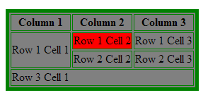
3. Tables…
Table Cellpadding and Cellspacing:
The two attribiutes cellpadding and cellspacing will allow you to adjust the white space in your table cell.
Cellspacing defines the width of the border, while cellpadding represents the distance between cell borders and the content within.

Slide 98
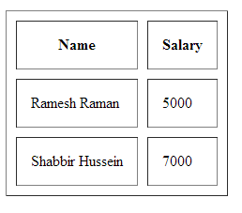
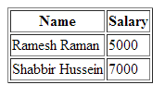
3. Tables…
Example:
<table border="1" cellpadding="15" cellspacing="10">
<tr> <th>Name</th> <th>Salary</th> </tr>
<tr> <td>Ramesh Raman</td> <td>5000</td> </tr>
<tr> <td>Shabbir Hussein</td> <td>7000</td> </tr>
</table>

Slide 99
3. Tables…
Attributes of rows and cells:
This attributes will be applicable only to the header cell or the data cell if it is used with <th> or <td> tag
It will affect the whole content of the row if it is used by the <tr> tag.
Attribute | Value | Description
align | left | right | center | justify | Aligns the content in a cell
bgcolor | rgb(x,x,x) | #xxxxxx | Colorname | Specifies a background color for a cell
colspan | number | Specifies the number of columns a cell should span
rowspan | number | Sets the number of rows a cell should span
height | Pixels | % (percent) | Sets the height of a cell
width | Pixels | %(percent) | Specifies the width of a cell
nowrap | nowrap | Specifies that the content inside a cell should not wrap
valign | top|middle|bottom | Vertical aligns the content in a table row

Slide 100
3. Tables…
Spanning rows and cells
<table border="1" cellpadding="2">
<tr>
<td>A cell</td>
<td>Another cell</td>
<td>Yet another cell!</td>
</tr>
<tr>
<td rowspan="2">A cell that spans two rows</td>
<td colspan="2">A cell that spans two columns</td>
</tr>
<tr>
<td>Another cell</td>
<td>The last cell</td>
</tr>
</table>

Slide 101
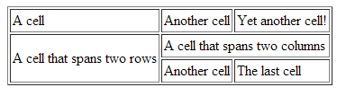
3. Tables…
Vertical alignment of cell content
If you set your table’s width to a small value, web browsers vertically align content in the middle of cells.

Slide 102
3. Tables…
You can use the valign attribute to set where the text is displayed vertically.
The attribute can be added to a row or cell start tag, and set to the desired value.

Slide 103
3. Tables…
Using a Header, Body, and Footer:
Tables can be divided into three portions: a header, a body, and a foot.
The head and foot remain the same for every page, while the body is the main content of the table.
The three elements for separating the head, body, and foot are:
<thead> - to create a separate table header.
<tbody> - to indicate the main body of the table.
<tfoot> - to create a separate table footer.
A table may contain several <tbody> elements to indicate different pages or groups of data.
But it is notable that <thead> and <tfoot> tags should appear before <tbody>.

Slide 104
Example:
<table border="1" width="100%">
<thead>
<tr> <td colspan="4">This is the head of the table</td> </tr>
</thead>
<tfoot>
<tr> <td colspan="4">This is the foot of the table</td> </tr>
</tfoot>
<tbody>
<tr> <td>Cell 1</td> <td>Cell 2</td> <td>Cell 3</td> <td>Cell 4</td> </tr>
<tr>
...more rows here containing four cells...
</tr>
</tbody>
<tbody>
<tr> <td>Cell 1</td> <td>Cell 2</td> <td>Cell 3</td> <td>Cell 4</td></tr>
<tr>
...more rows here containing four cells...
</tr>
</tbody>
</table>

Slide 105
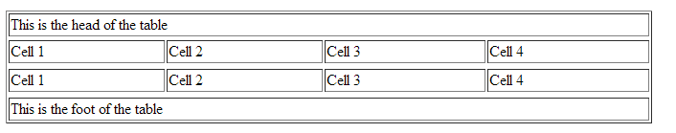
3. Tables…
This produces the following output:

Slide 106
Ordered and Unordered List
The most common HTML lists are ordered and unordered lists.
An ordered list: The first list item The second list item The third list item | An unordered list: List item List item List item

Slide 107
Ordered and Unordered List…
Unordered List
An unordered list starts with the <ul> tag.
Each list item starts with the <li> tag.
The list items are marked with bullets (typically small black circles).
The “type” attribute can be used to specifies the style of the bullets its value includes disc, square and circle.
Example:
<ul> <li>Banana</li> <li>Orange</li> </ul>
How the HTML code above looks in a browser:
Banana
Orange

Slide 108
Ordered and Unordered List…
<ul> attributes:
Attribute | Value | Description
compact | compact | Specifies that the list should render smaller than normal
type | disc square circle | Specifies the style of the bullet points of the list items

Slide 109
Ordered and Unordered List…
Ordered List
An ordered list starts with the <ol> tag.
Each list item starts with the <li> tag.
The list items are marked with numbers.
Example:
Types of fruits are:
<ol> <li>Banana</li> <li>Orange</li>
<li>Apple</li> </ol>
How the HTML code above looks in a browser:
Types of fruits are:
Banana
Orange
Apple

Slide 110
Ordered and Unordered List…
The start attribute:
If you want a numbered list to start at a number other than “1,” you can use the start attribute to specify another starting number.
Example
<ol start="17">
<li>Highlight the text with the text tool.</li>
<li>Select the Character tab.</li>
<li>Choose a typeface from the pop-up menu.</li>
</ol>
The resulting list items would be numbered 17, 18, and 19, consecutively.

Slide 111
Ordered and Unordered List…
The <ol> attributes:
Attribute | Value | Description
compact | compact | Specifies that the list should render smaller than normal
start | number | Specifies the start point for the list items
type | 1 I i A a | Specifies which kind of bullet points will be used

Slide 112
Ordered and Unordered List…
Example:
Types of fruits are:
<ol type=”I”>
<li>Banana</li>
<li>Orange</li>
<li>Apple</li>
</ol>
This produces the following attribute:
Types of fruits are:
Banana
Orange
Apple

Slide 113
Ordered and Unordered List…
Nesting Lists
One list can be put inside another to create nested list.
Example:
<ol>
<li>Super computer</li>
<li>Mainframe computer</li>
<li>Mini computer</li>
<li>Micro computer</li>
<ul>
<li>Desktop computer</li>
<li>Laptop Computer</li>
<li>Palmtop computer</li>
</ul>
</ol>

Slide 114
Ordered and Unordered List…
Definition lists
Definition lists vary only slightly from other types of lists in that list items consist of two parts: a term and a definition/description.
The term is given by the <dt> element and is restricted to inline content.
The description is given with a <dd> element that contains block-level content.
Definition (or dictionary) lists are used for lists of terms with their respective definitions.
The whole list is marked up as a definition list (<dl>) element.
The content of a <dl> is some number of terms (indicated by the <dt> element) and definitions (indicated by the <dd> element).
Here is an example of a brief definition list :

Slide 115
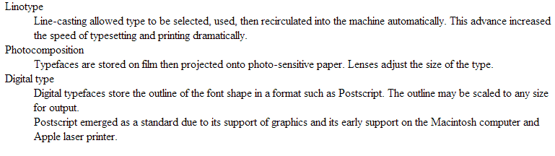
<dl>
<dt>Linotype</dt>
<dd>Line-casting allowed type to be selected, used, then recirculated into the machine automatically. This advance increased the speed of typesetting and printing dramatically.</dd>
<dt>Photocomposition</dt>
<dd>Typefaces are stored on film then projected onto photo-sensitive paper. Lenses adjust the size of the type.</dd>
<dt>Digital type</dt>
<dd><p>Digital typefaces store the outline of the font shape in a format such as Postscript. The outline may be scaled to any size for output.</p>
<p>Postscript emerged as a standard due to its support of graphics and its early support on the Macintosh computer and Apple laser printer.</p>
</dd>
</dl>

Slide 116
Grouping Elements: the DIV and SPAN Elements
The DIV and SPAN elements offer a generic mechanism for adding structure to documents.
The SPAN element defines the content to be inline and DIV to be block-level but both impose no other presentational idioms on the content.
Thus, authors may use these elements in conjunction with style sheets to tailor HTML to their own needs and tastes.
The div element is used to identify a block-level division of text.
You can use a div like a container around a logical grouping of elements on the page.
By marking related elements as a div and giving it a descriptive name, you give context to the elements in the grouping.
That comes in handy for making the structure of your document clear but also for adding style properties.

Slide 117
The DIV and SPAN Elements…
In this example, a div element is used as a container to create group
<div class="listing">
<cite>The Complete Manual of Typography</cite>, James Felici. A combination of type history and examples of good and bad type.
</div>
Here is another common use of a div used to break a page into sections for context, structure, and layout purposes.
In this example, a heading and several paragraphs are enclosed in a div and identified as the “news” section.
<div id="news">
<h1>New This Week</h1>
<p>We've been working on...</p>
<p>And last but not least,... </p>
</div>

Slide 118
The DIV and SPAN Elements…
A span offers all the same benefits as the div element.
It is used for inline elements that do not introduce line breaks.
Because spans are inline elements, they can only contain text and other inline elements (in other words, you cannot put block-level elements in a span).
Example:
<P><SPAN class="client-title">Client information:</SPAN> </P>

Slide 119
Frames
Frames can divide the screen into separate windows.
Each of these windows can contain an HTML document.
A file that specifies how the screen is divided into frames is called a frameset.
The frameset page lacks a <body> element (although it still requires head and title elements)
instead uses a <frameset> element, which sets the attributes for how the frames are positioned.
The frameset element houses frame elements, which define the location and attribute of each frame.

Slide 120
Frames…
When a frameset page is loaded, the browser automatically loads each of the pages associated with the frames.
Each HTML document is called a frame, and each frame is independent of the others.
The disadvantages of using frames are:
The web developer must keep track of more HTML documents
It is difficult to print the entire page
Users can’t save frame properly
The frameset element holds two or more frame elements.
Each frame element holds a separate document.
The frameset element sets no of columns or rows in the frameset and it uses <frameset> tag.
The <frame> tag defines one particular window (frame) within a frameset.

Slide 121
Frames…
<frameset cols="25%,75%"> <frame src="frame_a.htm" /> <frame src="frame_b.htm" /> </frameset>
The frameset column size can also be set in pixels (cols="200,500"), and one of the columns can be set to use the remaining space, with an asterisk (cols="25%,*").
You cannot use the body element together with the frameset element.
However, if you add a <noframes> tag containing some text for browsers that do not support frames, you will have to enclose the text in a body element.

Slide 122
Frames…
Attributes of frameset
Attribute | Value | Description
cols | pixels % * | Specifies the number and size of columns in a frameset
rows | pixels % * | Specifies the number and size of rows in a frameset

Slide 123
Frames…
Example:
<frameset cols="30%,*">
<frame src="frame-one.html">
<frame src="frame-two.html">
</frameset>

Slide 124
Frames…
Attributes of frame
Attribute | Value | Description
frameborder | 0 or 1 | Specifies whether or not to display a border around a frame
marginheight | pixels | Specifies the top and bottom margins of a frame
marginwidth | pixels | Specifies the left and right margins of a frame
noresize | noresize | Specifies that a frame cannot be resized
scrolling | yes no auto | Specifies whether or not to display scrollbars in a frame
src | URL | Specifies the URL of the document to show in a frame

Slide 125
Frames…
You can also nest framesets, to create a combination of columns and rows:
<frameset rows="120,*">
<frame noresize=”noresize” src="frame-one.html">
<frameset cols="150,*">
<frame src="frame-two.html">
<frame src="frame-three.html">
</frameset>
</frameset>

Slide 126
Frames…

Slide 127
Frames…
Nested Frames
Framesets may be nested to any level.
In the following example, the outer FRAMESET divides the available space into three equal columns.
The inner FRAMESET then divides the second area into two rows of unequal height.
Example:
<FRAMESET cols="33%, 33%, 34%">
<frame src=”one.html”>
<FRAMESET rows="40%, 50%">
<frame src=”two.html”>
<frame src=”three.html”>
</FRAMESET>
<frame src=”four.html”>
</FRAMESET>

Slide 128
Frames…
Working with iframes (internal frames)
The <iframe> tag defines an inline frame that contains another document.
<iframe>s enable you to update a page section without reloading the rest of it.
In addition, <iframe>s can be handy for enabling users to update a portion of a site’s design without touching the rest of the design.

Slide 129
<html>
<head>
<title>Internal Frame</title>
</head>
<body>
<p> Maths is the base of many sciences including engineering, computer science, physics, etc. </p>
<br> <br>
<iframe src ="test.html" width="100%" height="300">
<p>Your browser does not support iframes.</p>
</iframe>
<br> <br>
<table border="1">
<tr> <th>Name</th> <th>Salary</th> </tr>
<tr> <td>Chan Li</td> <td>5000</td> </tr>
<tr> <td>Anna Andrey</td> <td>7000</td> </tr>
</table>
</body>
</html>

Slide 130
HTML Forms
HTML forms are used to pass data to a server.
Users generally fill the form and submitting the form for further processing by server.
Forms are a vital tool for the webmaster to receive information from the web surfer, such as their name, email address, credit card, etc.
You may store that data into a file, place an order, gather user statistics, register the person to your web forum, or maybe subscribe them to your weekly newsletter.
A form will take input from the site visitor and then will post to your back-end application such as CGI, ASP, PHP script etc.
Then your back-end application will do required processing on that data in whatever way you like.

Slide 131
HTML Forms…
The <form> tag is used to create an HTML form:
<form> input elements </form>
The most important element inside form element is the input element.
The input element is used to accept user information.
An input element can vary in many ways, depending on the type attribute.
An input element can be of type text field, checkbox, password, radio button, submit button, and more.
The most used input types are described in the next subsections.
The form itself is not visible but form elements are visible.

Slide 132
HTML Forms…
Text Field
You can create text field by using:
<input type="text">
This defines a one-line input field that a user can enter text into.
Text fields have two important attributes: name and value.
The name attribute gives name to the text field for identification purpose and to make it easily accessible.
The value attribute sets content of the text field.
<form> First name: <input type="text" name="firstname"><br /> Last name: <input type="text" name="lastname"> </form>

Slide 133
HTML Forms…
The following is the list of attributes for <input type=”text”> tag.
name: the name attribute is required for identifying the input field name.
value : the value attribute specifies default text that appears in the field when the form is loaded.
size: by default, browsers display a text-entry box that is 20 characters wide, but you can change the number of characters.
maxlength: by default, users can type an unlimited number of characters in a text field regardless of its size.
You can set a maximum character limit using the maxlength attribute.
Example:
<input type="text" name="username" size="8" maxlength="8">

Slide 134
HTML Forms…
Password
A password field works just like a text entry field, except the characters are obscured from view using asterisk (*) or bullet (•) characters, or another character determined by the browser.
We can define a password field like:
<input type="password">
Example:
<form> Password: <input type="password" name="pwd"> </form>
How the HTML code above looks in a browser:
Password:

Slide 135
HTML Forms…
Text Area
At times, you may want your users to be able enter multiple line of text.
For these instances, use the <textarea> element that is replaced by a multi-line, scrollable text entry box when displayed by the browser.
Example:
<textarea name="comment"> Tell us what you feel about our tutorial with 50 words or less. </textarea>

Slide 136
HTML Forms…
Text Area attributes:
Text area has the following attributes:
name – name is used to identify the text area
rows - specifies the number of lines of text area should display.
Scrollbars will be provided if the user types more text than fits in the allotted space.
cols - specifies the width of the text area measured in number of characters.
Example:
<textarea name="comment" rows="5" cols="100"> Tell us what you feel about our tutorial with 50 words or less. </textarea>

Slide 137
HTML Forms…
Radio Buttons
Radio buttons are a popular form of interaction.
You may have seen them on quizzes, questionnaires, and other web sites that give the user a multiple choice question.
Below are a couple attributes you should know that relate to the radio button.
value: specifies what will be sent if the user chooses this radio button.
Only one value will be sent for a given group of radio buttons.
name: defines which set of radio buttons that it is a part of.

Slide 138
HTML Forms…
Radio buttons let a user select ONLY ONE of a limited number of choices.
We can define a radio button like:
<input type="radio">
Example
<form> <input type="radio" name="sex" value="male"> Male<br> <input type="radio" name="sex" value="female"> Female
</form>

Slide 139
HTML Forms…
Radio button attributes are:
name: sets name of the radio button
value: sets the value of the radio button. This is the data sent to server when the user submits the form.
checked: sets whether the radio button is checked by default or not. It accepts the value checked.
Example:
<form method=”post” action=”register.php”> <input type="radio" name="sex" value="male" checked=”checked”> Male <br> <input type="radio" name="sex" value="female"> Female
</form>

Slide 140
HTML Forms…
Checkboxes
Check boxes allow for multiple items to be selected for a certain group of choices.
The check box's name and value attributes behave the same as a radio button.
We can define a checkbox like:
<input type="checkbox">
Checkboxes let a user select ONE or MORE options.
Example:
<form> <input type="checkbox" name="vehicle" value="Bike"> I have bike <br> <input type="checkbox" name="vehicle" value="Car"> I have car </form>

Slide 141
HTML Forms…
Checkbox attributes are:
name: sets name of the checkbox
value: sets the value of the checkbox. This is the data sent to server when the user submits the form.
checked: sets whether the checkbox is checked by default or not. It accepts the value checked.
Example:
What type of food do you like?
<ul>
<li><input type="checkbox" name="genre" value=" spaghetti " checked="checked"> Spaghetti</li>
<li><input type="checkbox" name="genre" value="pizza" checked="checked"> Pizza</li>
<li><input type="checkbox" name="genre" value="sandwich">Sandwich </li>
<li><input type="checkbox" name="genre" value="Burger">Burger</li>
</ul>

Slide 142
HTML Forms…
Selection lists
Drop down menus are created with the <select> and <option> tags.
<select> is the list itself and each <option> is an available choice for the user.
Example:
Educational level: <br>
<select name="degree">
<option>Choose One</option>
<option>Some High School</option>
<option>High School Degree</option>
<option>Some College</option>
<option>Bachelor's Degree</option>
<option>Doctorate</option>
</select>

Slide 143
HTML Forms…
Attributes of select
Attribute | Value | Description
disabled | disabled | Specifies that a drop-down list should be disabled
multiple | multiple | Specifies that multiple options can be selected
name | text | Specifies the name of a drop-down list
size | number | Specifies the number of visible options in a drop-down list
Attribute of option
Attribute | value | Description
selected | selected | Specifies whether the option is selected or not when the form loads

Slide 144
HTML Forms…
Scrolling Lists
To make the menu display as a scrolling list, simply specify the number of lines you’d like to be visible using the size attribute.
Example:
Select the fruits you like:
<select name="fruits" size="6" multiple="multiple">
<option>Orange</option>
<option>Apple</option>
<option selected="selected">Banana</option>
<option selected="selected">Mango</option>
<option> Avocado</option>
<option>Pineapple</option>
<option>Papaya</option>
<option>Strawberry</option>
</select>

Slide 145
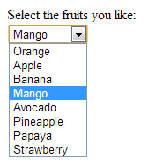
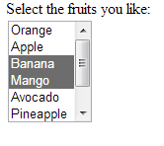
HTML Forms…
This produces the following output:

Slide 146
HTML Forms…
Button
There are a number of different kinds of buttons that can be added to web forms.
Some are:
submit button,
reset button, and
client side button.
Submit Button
When clicked, the submit button immediately sends the collected data in the form to the server for processing.
Submit button is defined as follows:
<input type="submit">

Slide 147
HTML Forms…
Submit button has the following attributes:
value: this sets the text displayed on the button as a label.
name: used to give name to the submit button
Example:
<input type=”submit” name=”info” value=”Send”>
Reset Button
The reset button returns the form controls to the state they were in when the form loaded.
This clears the text users typed into text fields, and removes selections made.

Slide 148
HTML Forms…
Reset button can be defined as follows:
<input type="reset">
Client Side Button
This is a button that is used to trigger a client-side script when the user clicks on that button.
This is used to execute scripting language such as JavaScript.
It has no predefined function on its own, as submit and reset buttons do.
Client side button can be defined as follows:
<input type="button">

Slide 149
HTML Forms…
Client side button has the following attributes:
value: this sets the text displayed on the button as a label.
name: used to give name to the button
Example:
<input type=”button” name=”adder” value=”Add”>
Image Button
This type of input control allows you to replace the submit button with an image of your choice.
The image will appear flat, not like a 3-D button.

Slide 150
HTML Forms…
Image button can be defined as follows:
<input type="image">
Image button attributes:
src: sets the image to be used as the submit button
value: text displayed on the button
name: name of the submit button
Example:
<input type="image" src="didessa.png" value="Submit">

Slide 151
HTML Forms…
The button element
The button element is a flexible element for creating custom buttons similar to those created with the input element.
The content of the button element (text and/or images) is what gets displayed on the button.
Attribute:
type = “submit|button|reset” – this attribute declares the type of the button.
submit: Creates a submit button. This is the default value.
reset: Creates a reset button.
button: Creates a push button.
In this example, a button element is used as a submit button.
The button includes a label and a small image.
<button type="submit" name="submit">
<img src="thumbs-up.gif" alt=""> Ready to go.
</button>

Slide 152
HTML Forms…
Hidden controls
There may be times when you need to send information to the form processing application that does not come from the user.
In these instances, you can use a hidden form control that sends data when the form is submitted, but is not visible to user.
<input type="hidden">
Hidden controls are added using the input element with the type set to hidden.
Its sole purpose is to pass a name/value pair to the server when the form is submitted.
Example:
<input type="hidden" name="page" value="http://www.example.com/littlechair_thankyou.html">

Slide 153
HTML Forms…
File selection control
Web forms can collect more than just data.
They can also be used to transmit external documents from a user’s hard drive.
For example, a printing company could use a web form to receive artwork for a business card order.
A magazine could use a form on their site to collect digital photos for a photo contest.
The file selection control makes it possible for users to select a document from the hard drive to be submitted with the form data.
It is added to the form using our old friend the input element with its type set to file.
Example:
<input type="file">

Slide 154
HTML Forms…
The browser displays a “file” input as a text field with a button that allows the user to navigate the hard drive and select the file for upload.
Example:
<input type="file" name="photo" size="28" id="form-photo">
It is important to note that when a form contains a file selection input element, you must specify the encoding type (enctype) of the form as multipart/form-data and use the POST method.
Example:
<form action="client.php" method="post" enctype="multipart/form-data">
<p> Send a photo to be used as your online icon:<br>
<input type="file" name="photo" size="28" id="form-photo" /></p>
</form>

Slide 155
<html>
<head> <title>Form Elements</title> </head>
<body>
<form name="test" method="post">
First name: <input type="text" name="fname"> <br>
Last name: <input type="text" name="lname"> <br>
Sex: <input type="radio" name="sex" value="male" checked> Male
<input type="radio" name="sex" value="female"> Female
<br>
Educational level: <br>
<select name="education" size="6">
<option>Primary School</option> <option>Secondary School</option>
<option>College Diploma</option> <option>First Degree</option>
<option>Masters Degree</option> <option>PhD</option>
</select> <br>
Which fields are you interested in? <br>
<input type="checkbox" name=“choice1" value="Electronics"> Electronics <br>
<input type="checkbox" name=“choice2" value="Software Engineering"> Software Engineering <br>
<input type="checkbox" name=“choice3" value="Computer Engineering"> Computer Engineering <br>
<input type="checkbox" name=“choice4" value="Networking"> Networking
<br> <br>
Tell us what you feel about our tutorial with 50 words or less. <br>
<textarea name="comment" rows="10" cols="50"> </textarea> <br>
<input type="submit" name="submit">
</form>
</body>
</html>

Slide 156
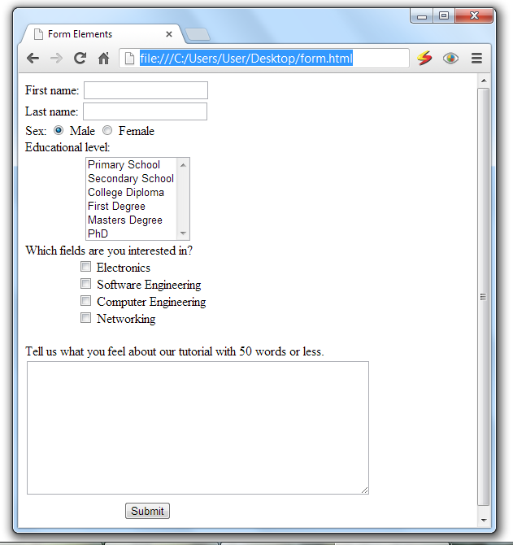

Slide 157
HTML Forms…
Linking HTML Forms with PHP Scripts
To create a link between PHP scripts and HTML forms, we need to use the submit button, and the attribute of the <form tag>, specifically “action” and “method”.
Buttons:
Submit buttons: When activated, a submit button submits a form.
A form may contain more than one submit button.

Slide 158
HTML Forms…
A submit button is used to send form data to a server.
The data is sent to the page specified in the form's action attribute .
The file defined in the action attribute usually does something with the received input:
<form name="input" action="action.php" method="get"> Username: <input type="text" name="user"> <input type="submit" value="Submit">

Slide 159
HTML Forms…
Automating Processing: Info Forms and Emails
If you would like to provide your web site visitors with a simple way to contact you from your web site, but really don't want to display your email address, this HTML form code may be what you're looking for.
You can create a simple form, to enable your visitors to send you comments, questions, product support requests, or whatever you'd like.
<form action=‘mailto:test@yahoo.com’ method=“post" enctype="text/plain">
Your Name: <input type="text" size="20“ name="VisitorName"> <br><br>
Your Comment: <textarea name="VisitorComment" rows="4" cols="20">
</textarea><br><br>
<input type="submit" value="Email This Form">
</form>

Slide 160
Inserting Multimedia
You can add music or video into your web page.
The easiest way to add video or sound to your web site is to use <embed> tag.
The src attribute of <embed> tag defines what video/audio file to embed into the page.
This tag causes the browser itself to include controls for the multimedia automatically.
Example:
<embed src="example.mpeg" autostart="false" />

Slide 161
Inserting Multimedia…
The following is the list of important attributes for <embed> element.
align - determines how to align the object. It takes either center, left or right.
autostart - Indicates if the media should start playing automatically. Netscape default is true, Internet Explorer is false.
loop - Specifies if the sound should be played continuously (set loop to true), a certain number of times (a positive value) or not at all (false). This is supported by Netscape only.
playcount - Specifies the number of times to play the sound. This is alternate option for loop if you are usiong IE.
hidden - Defines if the object shows on the page. A false value means no and true means yes.
height – set height of the object.
width – set width of the object.
pluginspage - Specifies the URL to get the plugin software.
name - A name used to reference the object.
src - URL of the object to be embedded. This can be any recognizable by the user's browser. It could be .mid, .wav, .mp3, .avi and so on).
volume - Controls volume of the sound. Can be from 0 (off) to 100 (full volume). This attribute is supported by Netscape only.
Controller – whether to show controllers like play, stop, pause, etc.

Slide 162
Inserting Multimedia…
Example:
<embed src="http://www.computerhope.com/issues/ibm-linux.mov"
Pluginspage="http://www.apple.com/quicktime/" width="320" height="250"
CONTROLLER="true" LOOP="false" AUTOPLAY="false" name="IBM Video">
</embed>
File types that are supported by the embed tag are Flash movies (.swf), mpeg(.mpg or .mpeg), AVI's (.avi), and MOV's (.mov).
.swf files - are the file types created by Adobe Flash program.
.wmv files - are Microsoft's Window's Media Video file types.
.mov files - are Apple's Quick Time Movie format.
.mpeg files - are movie files created by the Moving Pictures Expert Group.
Macromedia's .swf and .mpeg formats may be the best options for web because the high compression reduces file size and expedites the download periods for your page visitors.

